Slide 1

GenAI

Slide 2
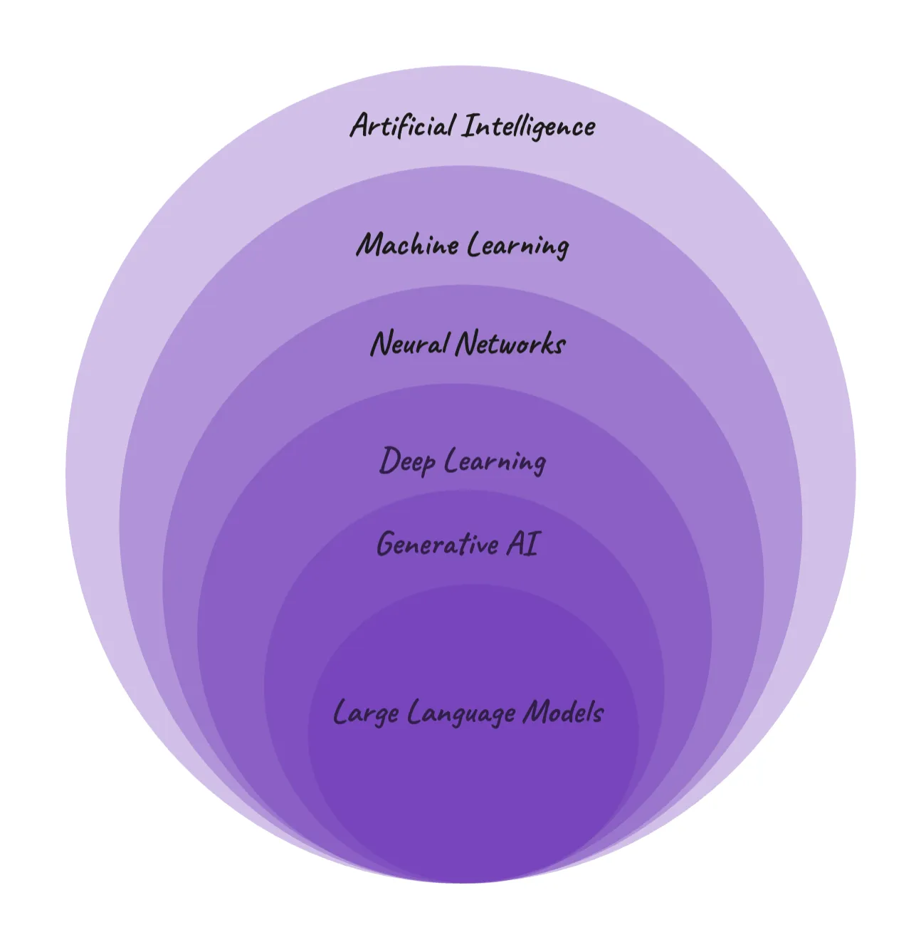
What is Generative AI?
Generates various types of content based on pre-trained data including
Text
Imagery
Audio
Synthetic Data
Subset of Deep Learning
Deep learning uses ANNs which can process more complex patterns than Machine Learning, which uses semi-supervised learning. This helps to learn basic concepts of tasks and generalize to new concepts.

Slide 3
1950s
IT pioneers like Alan Turing and John McCarthy played a pivotal role in laying the foundation for GenAI when they proposed early models of computation based on the idea that machines could one day mimic human intelligence.
1960s
Early versions of GenAI were the Hidden Markov Models (HMMs) and Gaussian Mixture Models (GMMs).
1980s
Further developments resulted in the creation of models like Restricted Boltzmann Machines (RBMs) and Variational Autoencoders (VAEs) which laid the foundation for more sophisticated generative models.
2000s
GenAI began to gain momentum thanks to the advancements in machine learning and deep learning (DL) to create neural networks – interconnected layers of “neurons” that process and learn from data like the human brain.
2014
The specific type of neural network developed in 2014 by Ian Goodfellow and colleagues is called a Generative Adversarial Network (GAN).
Generative pre-training models like Word2Vec and GloVe are introduced. These models can learn latent representations of words, which can be useful for tasks like machine translation and text generation.
2016
DeepMind's WaveNet model is introduced. This model can generate realistic speech, demonstrating the capability of Gen AI for creative audio applications.
OpenAI's GPT-2 language model is introduced, demonstrating impressive capabilities in generating realistic and coherent text formats, like poems, code, scripts, musical pieces, emails, letters, etc.
2019
2024
Open AI’s most powerful text-to-video generator Sora was introduced

Slide 4
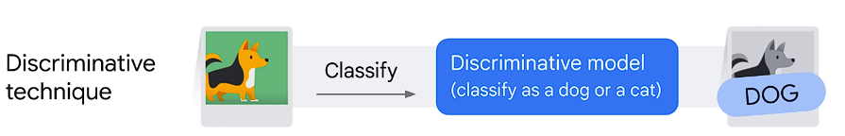
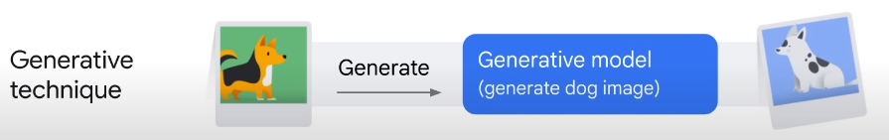
Deep Learning Model Types
Discriminative
Used to classify or predict
Trained on labeled data points and they learn the relationship between the features of the data points and the labels
Once trained it can be used to predict the label for new data points.
Generative
Generates new data instances based on the learned probability distribution of existing data.
Generates new data that is similar to the data it was trained on.
Predict new word in sequence

Slide 5
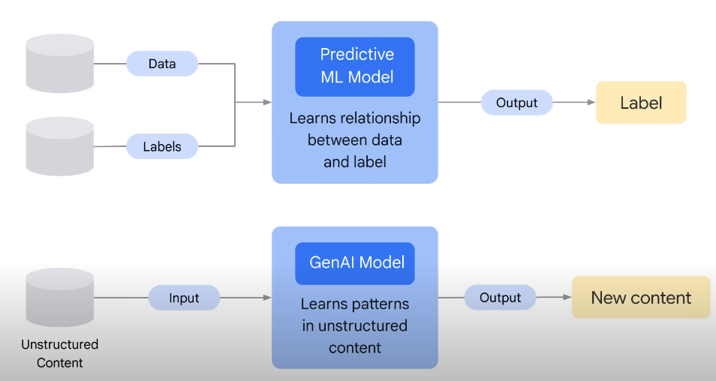
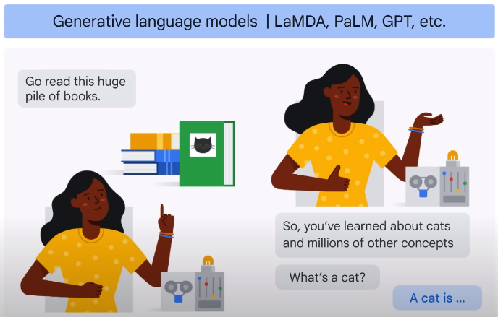
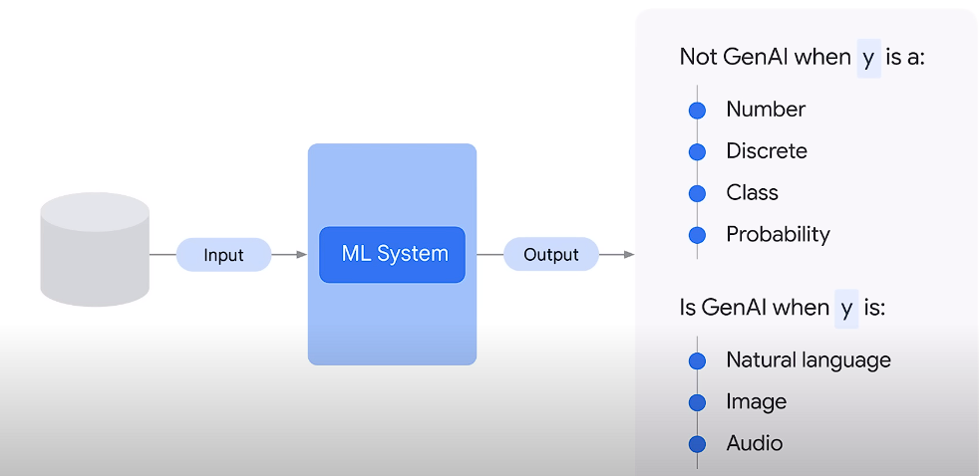

Slide 6
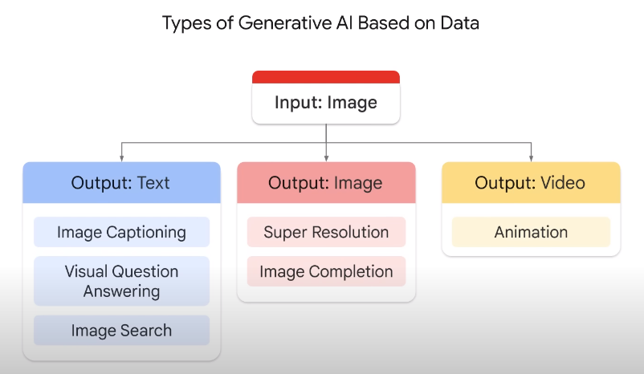
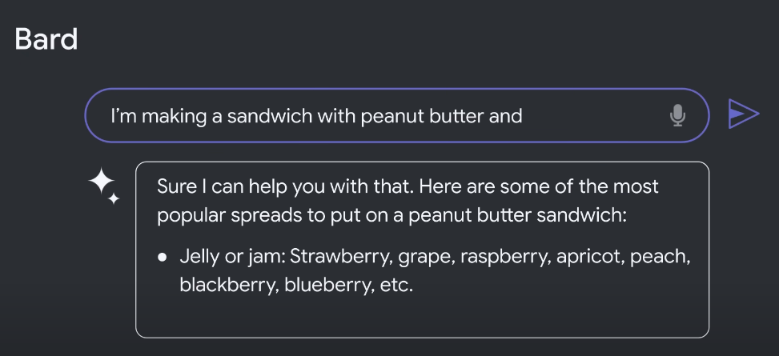
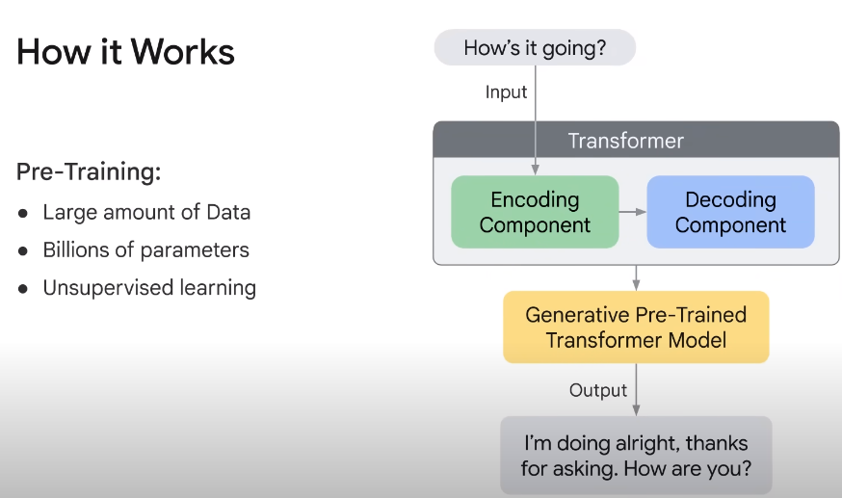
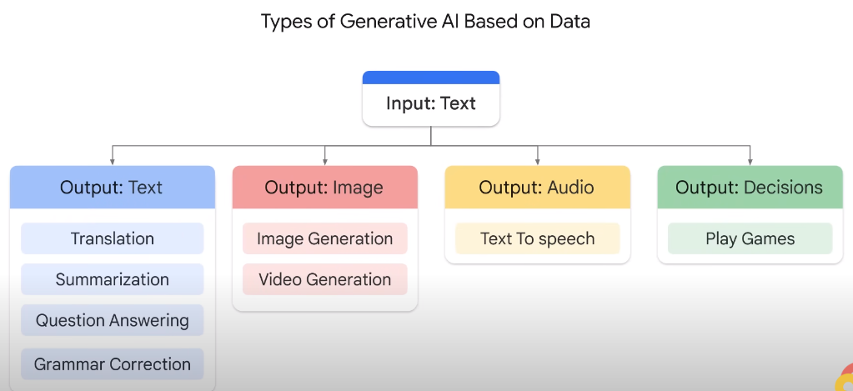

Slide 7
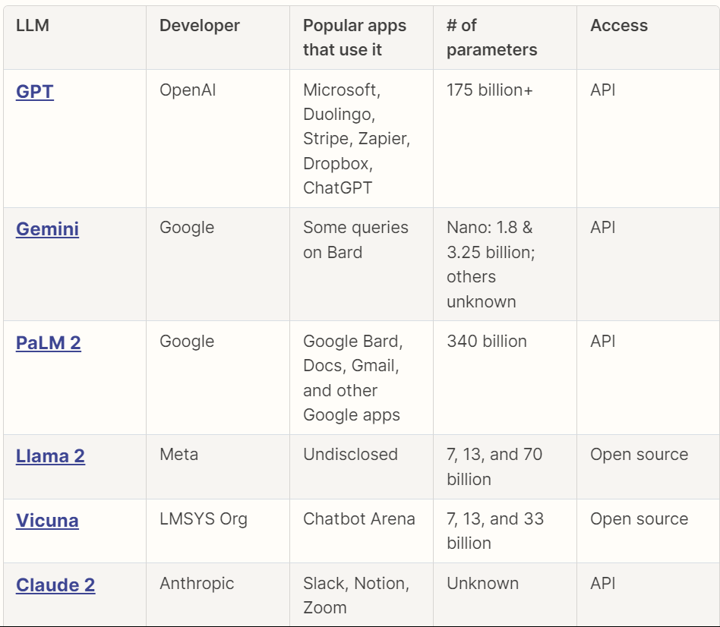
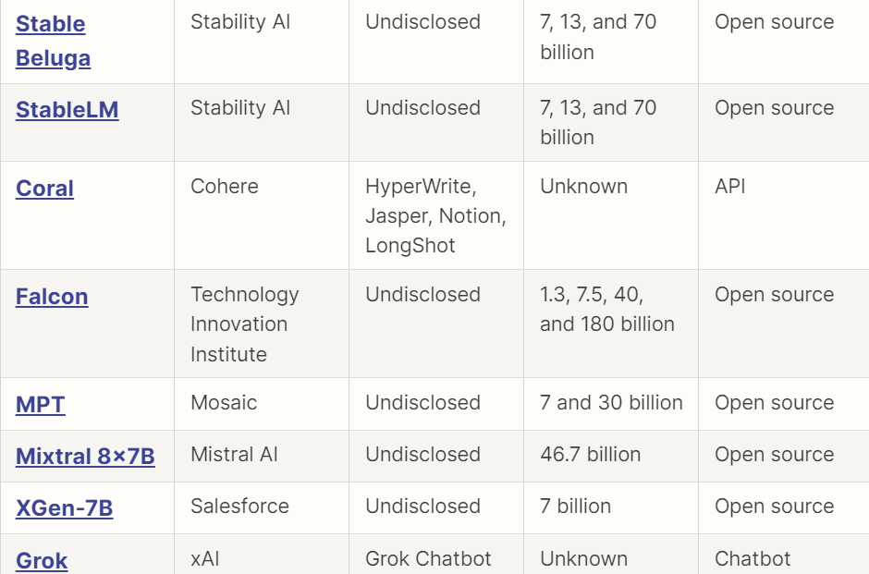
LLMs
Large training datasets, Large number of parameters, General purpose
Large, general–purpose language models can be pre-trained and then fine-tuned for specific purposes
LLMs are trained to solve common language problems like- Text classification, question answering, document summarization, and text generation across industries
And then be fine-tuned to solve specific problems in different fields, like retail, finance, entertainment, journalism, education, healthcare, customer service, Science, real estate, manufacturing
Types
Generic Language Models
Instruction Tuned
Dialog Tuned

Slide 8
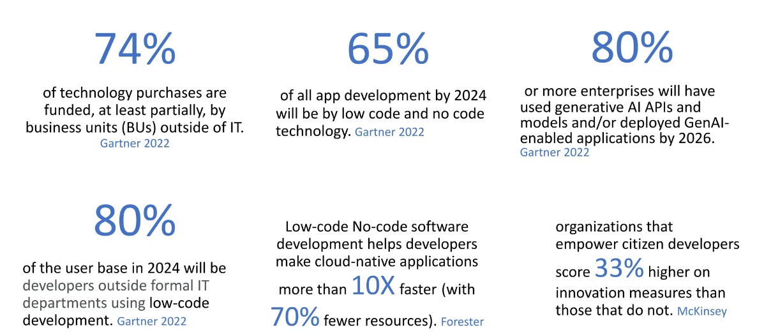
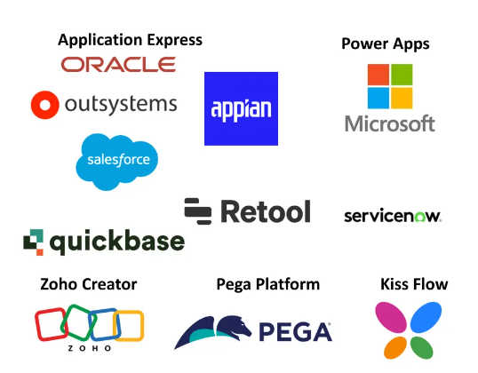
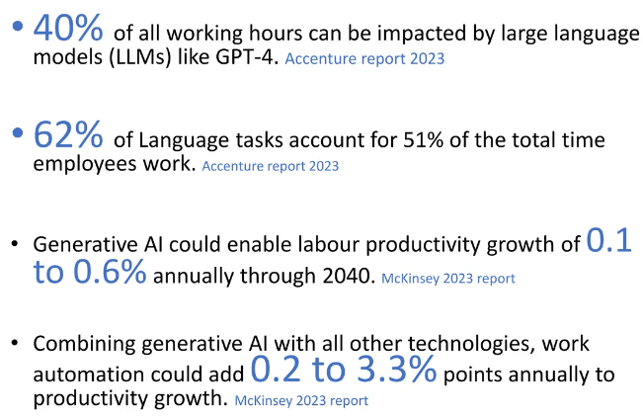
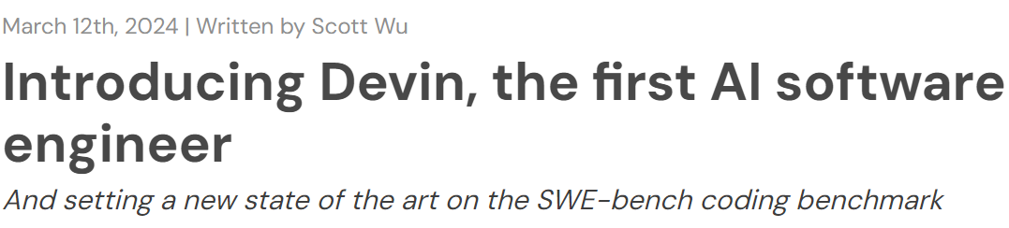
No Code Adoption
Benefits of low code/no code:
Faster Development
25 – 30% Lower Costs
Improved Collaborations
Easier Maintenance
No Coding Skills
Benefits from Cloud

Slide 9






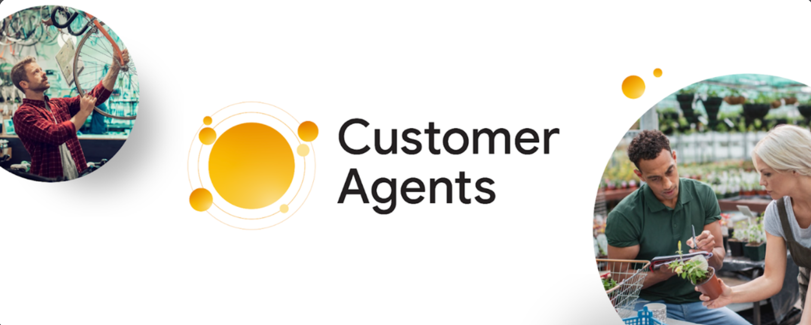
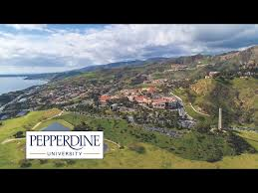

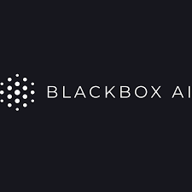
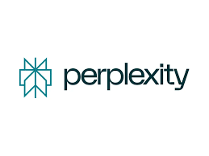

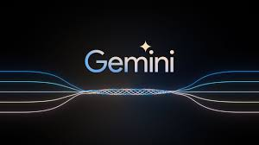
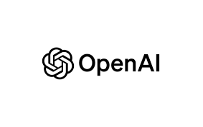

Slide 10








Convert sketches and descriptions into designs
Enhancing Content Creation
There are so many creative Gen AI tools, if you want the list of them go ahead and give a prompt in perplexity, ChatGPT, Gemini, etc

Slide 11
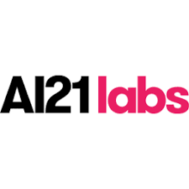
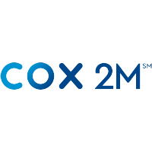


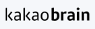
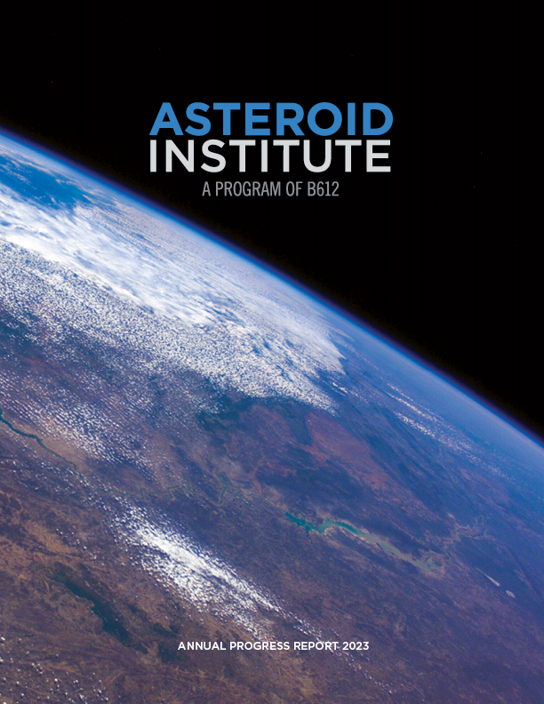


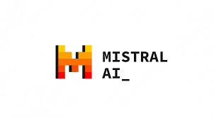
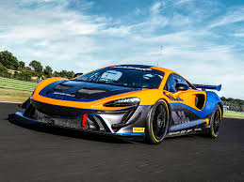

Data agents are like having knowledgeable data analysts and researchers at your fingertips

Slide 12
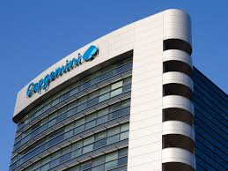


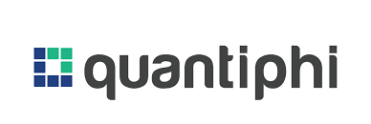
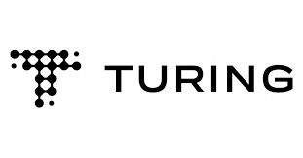
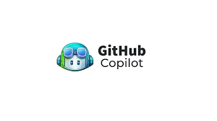
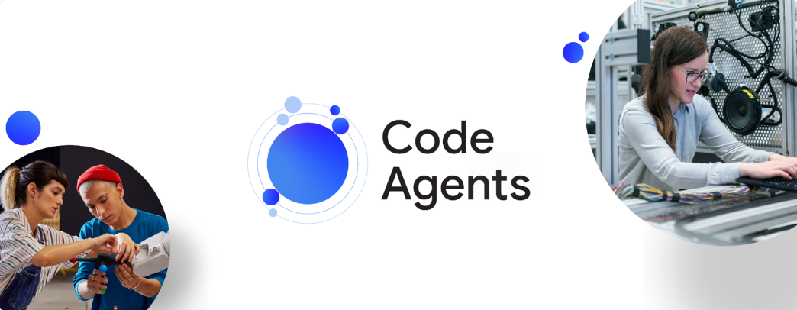
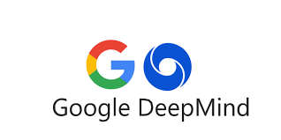
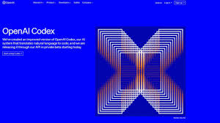
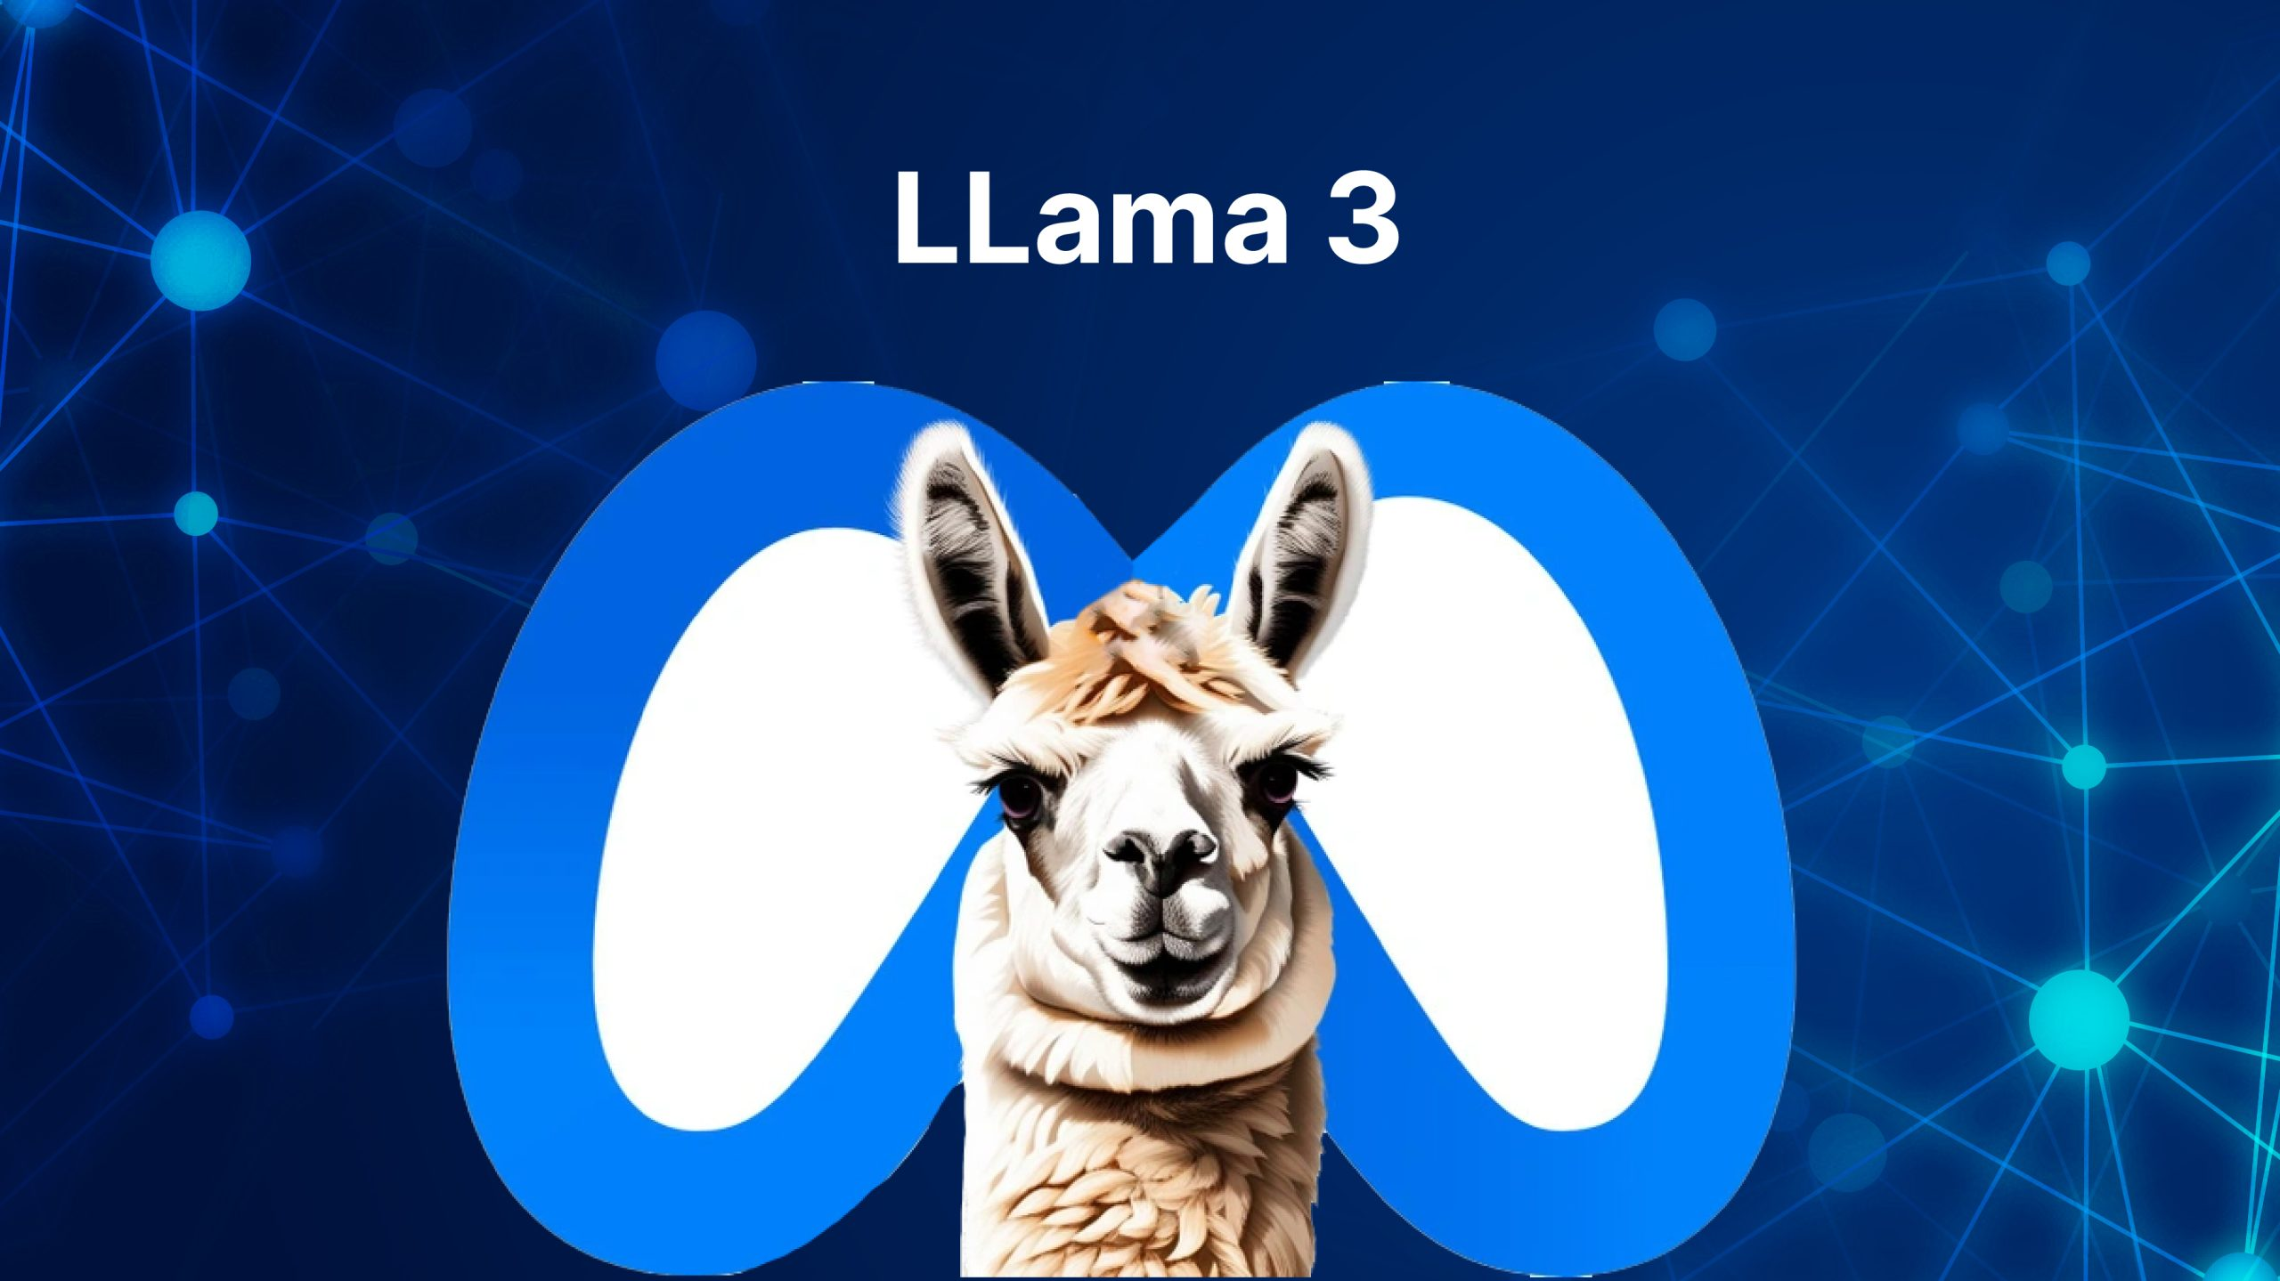

Code agents are helping developers and product teams to design, create, and operate applications faster and better

Slide 13
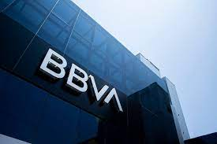
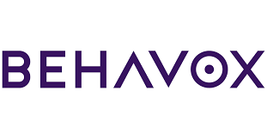






Security agents assist security operations by radically increasing the speed of investigations, automating monitoring and response for greater vigilance and compliance controls

Slide 14
Top 100+ Generative AI Applications / Use Cases in 2024

Slide 15
Generative AI Statistics for 2024

Slide 16
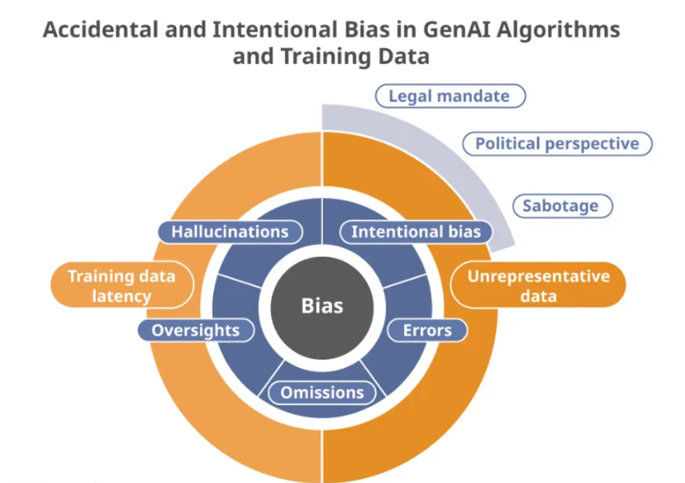
Challenges and Ethical Considerations
Bias in GenAI Models
Lack of explainability
Inherent English and European bias of training data
Lack and impact of regulation, now and in the future
Untruthful, Toxic, or Irrelevant Outputs
Data Privacy and Security
Fairness
Transparency
Explainability
So manyyy..
Source: Medium
Perplexity
Misinformation and Deepfakes
Prioritize diversity in training datasets
Copyright and Legal Exposure
Data Privacy Violations

Slide 17
Conclusion
Generative AI (GenAI) is a subset of deep learning that uses neural networks to generate various types of content like text, imagery, audio, and synthetic data based on pre-trained data.
Key developments in GenAI include Generative Adversarial Networks (GANs), pre-training models like Word2Vec and GloVe, and large language models like GPT-2 and DALL-E that can generate realistic text, speech, and images.
Large Language Models (LLMs) are a significant part of GenAI, trained on massive datasets to solve language tasks across industries and then fine-tuned for specific use cases.
No-code/low-code adoption of GenAI tools offers benefits like faster development, lower costs, improved collaboration, and accessibility to non-coders.
While promising, GenAI faces challenges like bias, lack of explainability, misinformation, deepfakes, data privacy, and legal issues that need to be addressed through regulation and ethical practices.

